Slide 1
Distributed Database Systems
Welcome!

Slide 2
Teaching Staff
Instructor: Ju Fan (范举)
Associate Professor
School of Information / DEKE Lab
Renmin University of China Email: fanj@ruc.edu.cn
Homepage: http://iir.ruc.edu.cn/~fanj/
Office: Room 500, Information Building

Slide 3
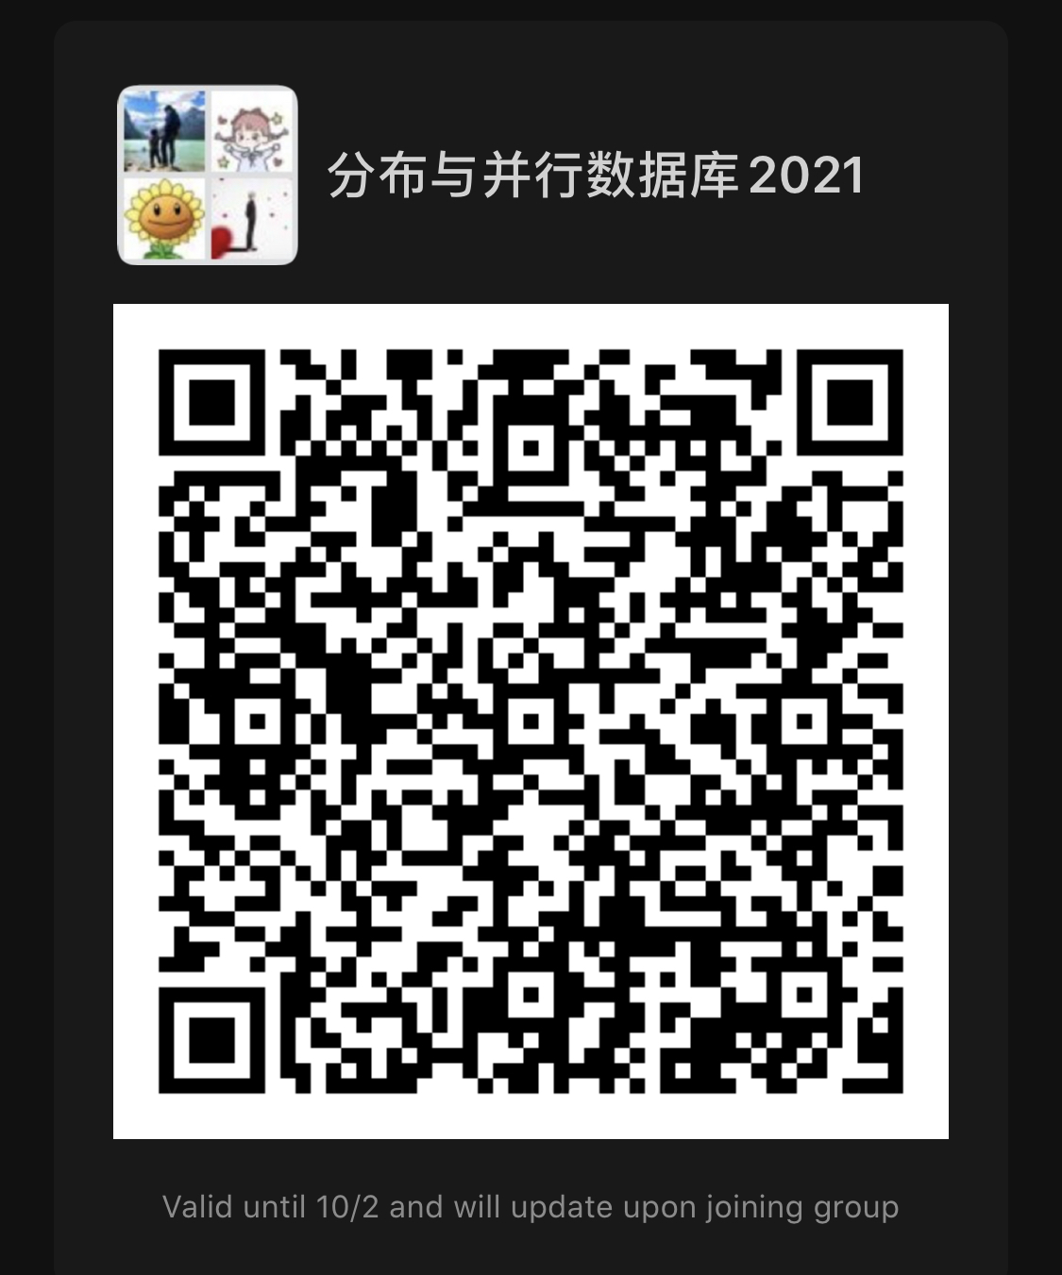
Teaching Staff
Teaching Assistant :
Xiaotong Li（李晓桐）
Master Student
School of Information
Renmin University of China
kk15910306736@163.com

Slide 4
Course Name
Distributed
Database
Systems

Slide 5
Teaching language
English

Slide 6
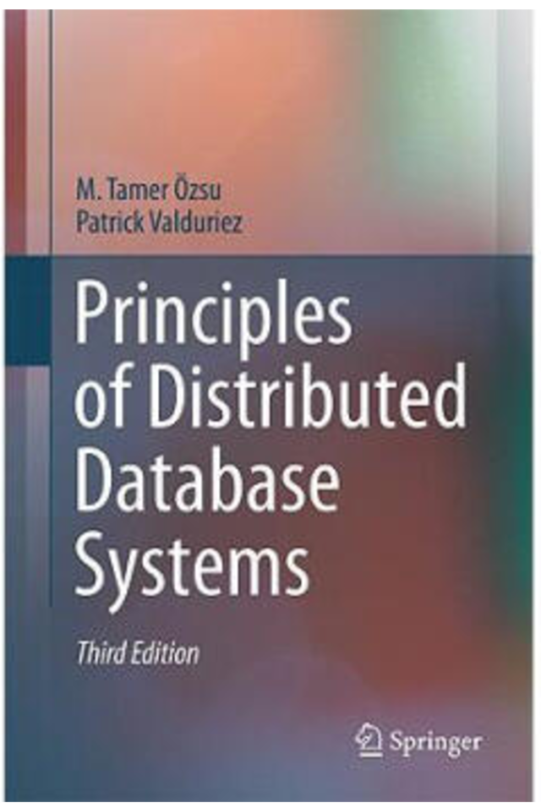
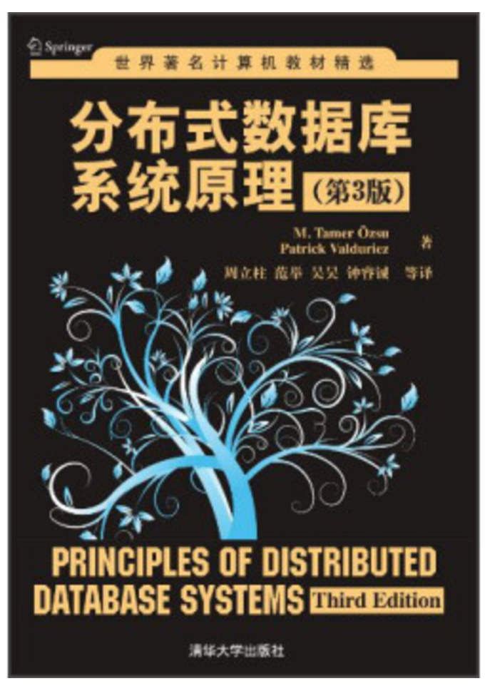
Textbook
Principles of Distributed Database Systems
(3nd Edition)
M. Tame Özsu
Patrick Valduriez
Springer, 2011
Price: RMB 73.30

Slide 7
Reference
Distributed Databases: Principles and Systems Ceri & Pelagatti McGraw-Hill, 1985
许多中文参考书

Slide 8
Prerequisite
Undergraduate database course
Computer networks

Slide 9
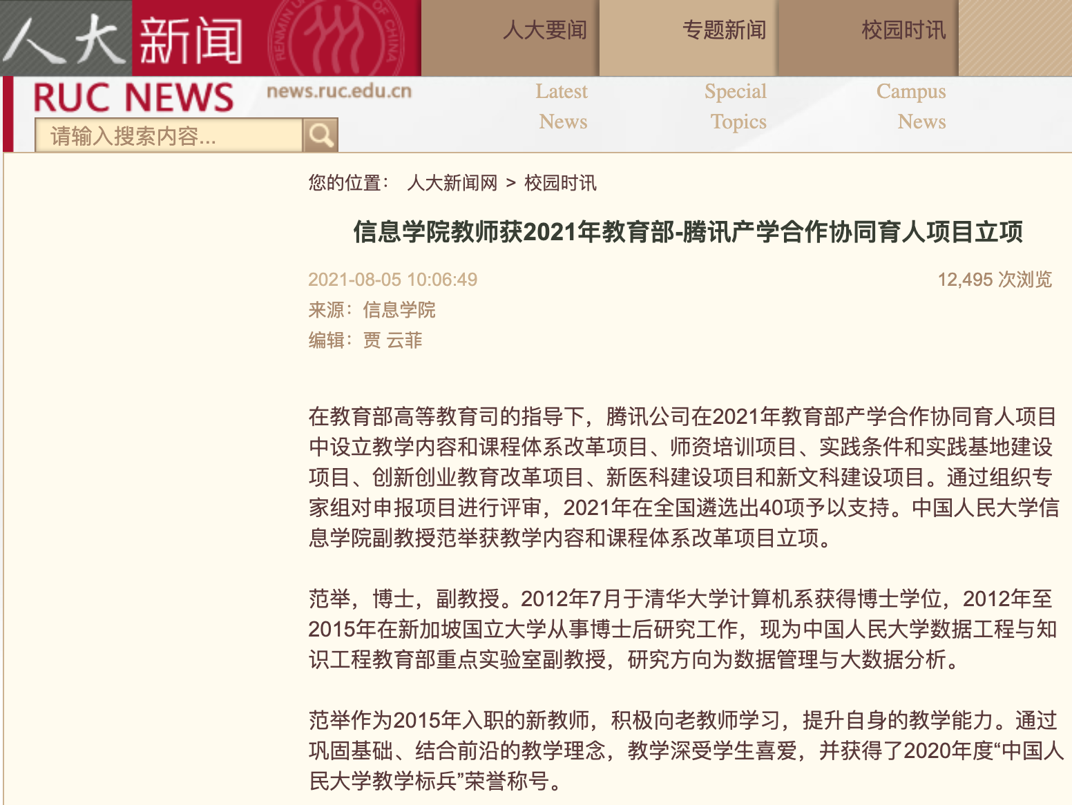


What is new in this semester?

Slide 10

What is new in this semester?
Get Your Hands Dirty!

Slide 11
Syllabus
Wk. | Date | Chapter # | Title
3 | 26 Sep | Ch1 | Introduction
4 | 28 Sep | Ch3 | Distributed Database Design
6 | 12 Oct | Ch6 | Overview of Query Processing
7 | 19 Oct | Ch7 | Query Decomposition and Data Localization Course Project Kick-off
8 | 26 Oct | TDSQL | Practice of Distributed Databases in Tencent
9 | 2 Nov | Ch8 | Optimization of Distributed Queries - 1 Hands-on Tutorial on ETCD

Slide 12
Syllabus
Wk. | Date | Chapter # | Title
10 | 9 Nov | TDSQL | Hands-on Tutorial on TDSQL - 1
11 | 16 Nov | Ch8 | Optimization of Distributed Queries – 2 Hands-on Tutorial on RPC
12 | 23 Nov | TDSQL | Hands-on Tutorial on TDSQL - 2
13 | 30 Nov | Ch7 | Optimization of Distributed Queries – 3 Mid-term Project Report
14 | 7 Dec | Ch10 | Introduction to Transaction Management
15 | 14 Dec | Ch11 | Distributed Concurrency Control

Slide 13
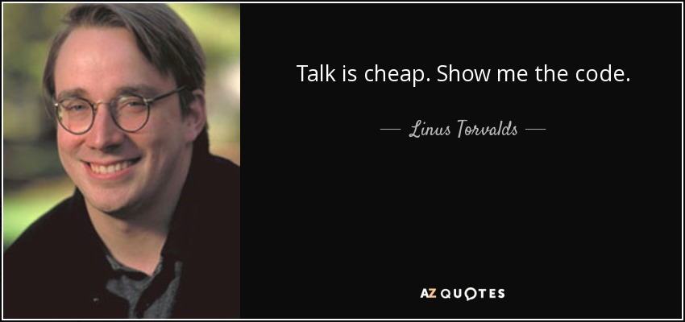
Syllabus
Wk. | Date | Chapter # | Title
16 | 21 Dec | Ch12 | Distributed DBMS Reliability - 1
17 | 28 Dec | Ch12 | Distributed DBMS Reliability - 2
18 | 9 Jan | NA | Project Examination
19 | 16 Jan | NA | Project Report Submission

Slide 14
Contents - Project
Design and implementation of a course project of DDBMS capable of
defining DDB
support of SQL
Teamwork of 3-4 members
To be evaluated by a benchmark of data and queries
Demo

Slide 15
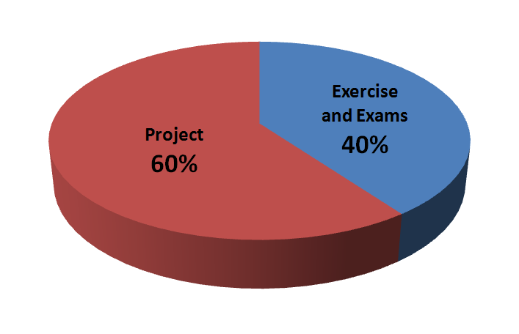
Evaluation

Slide 16
Course home page
https://github.com/fanju1984/ddb/wiki
On the home page you can
Get notifications
Download the latest courseware
Download other related materials

Slide 17
Why take this course?

Slide 18
History of DB Systems
1960’s
IBM IMS
DBTG network data model
1970’s
E. F. Codd RDB model
Pioneering systems: INGRES, System R
1980’s
Booming of RDBs
Federated, Multi-database
DDB
OODB

Slide 19
History of DB Systems
1990’s
Merge of RDB and OODB
Internet Fame
P2P model
2000’s
XML DB
Web data processing
Semantic Web
Data Integration

Slide 20
History of DB Systems
2010’s
NoSQL
NewSQL
More details in course 分布式系统与云计算（卢卫、覃雄派）

Slide 21
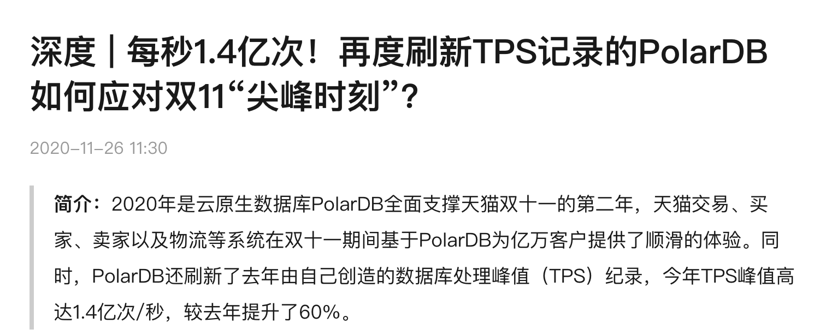
Why study DDB
Notes:
A barrage of doubts came after OceanBase's ascension to the world championship.
Some people pointed out that Oracle's performance data was nine years old and did not reflect subsequent hardware improvements. Others noted that in 2013, Oracle achieved a performance score of 8 million tmpC (transactions per minute) with one single workstation and could set up a cluster with up to 27 workstations. In other words, Oracle could have achieved a performance score of up to tens or even hundreds of millions of tmpC.
That took the wind out of the team's sails. Yang Zhenkun, the founder of OceanBase, frowned and said, "I guess we'll have to try again."
In May 2020, OceanBase took the TPC-C benchmark test for the second time and finished with a final score of 707 million tpmC, setting a new record and improving the last year's performance by a factor of 11.6. In contrast to the massive resources allocated to last year's test, it only involved two teams in Hangzhou and Beijing this time. Although the experts had to work day and night, they sailed right through the second test. To quote the words of Cao Hui, a technical expert with the OceanBase team, it was because "we had been through the twists and turns and come out on the other side."

Slide 22
Why study DDB
Notes:
首先作为适应于金融场景的数据库，数据强一致性是立命之本，因为数据不能丢、不能错。在金融场景，你没有办法去估量——假如错一条数据，到底这条数据是1分钱还是1个亿，所以数据强一致是我们最根本的一个特性。不允许丢，不允许错，这是对数据库起码的要求。
第二是金融级高可用。TDSQL确保99.999%以上的可用性，并支持跨IDC、多机房、同城多活的部署方式。我们最先切入金融场景是因为金融场景的挑战是最大的。中国金融行业受监管要求最为苛刻，同时也对数据和业务的可用性、可靠性、一致性更是有极高的要求。我们要求99.999%的可用性，也就是说这个数据库全年故障的时间不能超过5分钟。
第三是高性能、低成本。互联网时代的企业，都是海量业务、海量机器，性能稍微提高一个10%，可能就节约成百上千台机器的成本，这个经济效益还是比较大的。所以高性能、低成本也是TDSQL的一个关键特性。
第四点是线性水平扩展。因为无论是互联网还是其他企业，随着数字化的发展，比如说出现突增流量，搞个活动等，现在单机的承载量越来越容易凸显出瓶颈。所以我们提出这种水平线性扩展的能力，要求它可进行水平伸缩。可能一台机器的负载、硬盘、机器资源容纳不了，但可以把它拆到多台机器，不需要考虑太多，它可以自动地提高自身吞吐量和负载量。
第五点是企业级安全。金融数据是敏感的，一些敏感的金融数据需要在当前数据基础上再做一层更高级别的企业安全防护，比如数据库防火墙，以及透明加密，等等。
第六点是便捷的运维，私有化部署中，很多情况下其实他们的网络环境和部署环境跟我们是隔离的，如果银行客户有问题，那其实我们第一时间是切入不了去帮助解决的，所以就需要一套完善的配套设施，简单容易上手，可以自动帮用户去定位问题、解决问题，同时也尽量减少运维的复杂度。

Slide 23
Why study DDB
Reason 1: The fundamental principles for parallel & distributed data processing
Reason 2: Scientific training on

Slide 24
Why study DDB
Reason 1: The fundamental principles for parallel & distributed data processing
Reason 2: Scientific training on
basic concepts
problem formulation
identification of key technical issues
algorithm presentation
system level design and implementation

Slide 25
Why study DDB
Reason 1: The fundamental principles for parallel & distributed data processing
Reason 2: Scientific training
Reason 3: Hands-on practice on
Building a tiny DDBMS system
Playing with TDSQL

Slide 26
往届学生反馈……
都觉得有难度……
在编码的过程中遇到了许许多多的问题
项目伊始，我就预料到工作量可能比较大
我会记住 12.30 午夜阳光地带编程的
当自己三步一Bug，每天Debug想要放弃的时候，发现已经写了这么 多，征服它的愿望越来越强烈，还好最后坚持下来了
这门课真是一点也不“水”
这门课收获颇丰，之前没写过这么多 c++代码，这一次得到了充分的锻炼。

Slide 27
往届学生反馈……
但都觉得收获很大！
我在这门课学习了分布式系统的知识、提升了coding能力、锻炼了团队合 作的能力
在本次大作业中有许多收获：明白了数据结构对于整个系统实现的重要性……其次，任务的切割也非常重 要。
这门课真的满满干货，上的很值得，大作业做的也很值得，原来 我真的可以学计算机耶!
感谢范老师，他讲课超棒!这门课很硬，收获很大
总结一下，选这门课，值。
我的收获是，遇事不要慌，离开座位，去喝点热水比什么都管用。

Slide 28
Friendly Reminding Messages from the Instructor

Slide 29
课程设计中应注意的问题
选课太多，疲于奔命，无暇顾忌
缺乏总体设计，系统划分不当，随意编程，接口混乱
设计目标很高，实现时想一步到位，指望一次成功
选择开发环境欠考虑
代码管理混乱，难以形成正确版本

Slide 30
实现时不考虑调试需求（例如反复建立表格，生成数据字典）
匆忙上马，反复折腾
各自为战，缺少交流
众人平等，没有核心
分工不均，事后抱怨

